Slide 1
De-escalation and Suicidal Ideation Part II: How Can QRs Best Support Clients With Significant Mental Health Issues
Alexia Martin, MA, MSW (‘21)
Anem Shariff, MSW MPH​​
National Qualified Representatives Program

Slide 2
Who we are
Anem Shariff is the Program Associate for the NQRP team at the Vera Institute of Justice. She completed her dual Master of Social Work and Master of Public Health degrees at New York University. She has clinical social work experience interning at the Program for Survivors of Torture at Bellevue Hospital in New York City. Prior to joining Vera, Anem was the Director of Development at Resources and Help Against Marital Abuse, or RAHAMA, a domestic violence agency that provides culturally specific DV services to the immigrant, refugee, asylee, and Muslim communities.
Alexia Martin is a Master of Social Work intern for the Center on Sentencing and Corrections & the Center on Immigration and Justice at Vera Institute of Justice. Alexia currently attends the University of Southern California, but previously completed a Master of Arts in Drama Therapy at New York University. Alexia has clinical experience working with clients who suffer from severe mental illness at Goodwill Industries of Greater New York's Rebound Program. She has also worked with domestic violence victims at LAPD’s Newtown Division. Here, she developed literature focused on community based mental health resources for perpetrators of domestic violence, which is now used department wide by LAPD.

Slide 3
Disclaimer
Content warning and giving space when needed:
Today's topic will be quite heavy and will deal with issues surrounding suicide and self-harm. If you need to step away from the training because you are feeling overwhelmed or are unable to continue, please feel free to mute the training, briefly step away, or exit if needed. The training will be recorded and shared with the NQRP/Vera networks for later reference. We will be making space for additional check-ins to ensure everyone participating is comfortable before continuing each topic.

Slide 4

Important Considerations
This is difficult to deal with, even for mental health professionals
Be aware of the potential for secondary/vicarious trauma and have positive coping mechanisms ready
Ultimately, you are not responsible for another person’s thoughts or actions
Passive support vs. Active support

Slide 5

Today's To Do
What is Suicidal Ideation
Suicide vs. Self Harm
Risk Factors & Warning Signs
What can you do?
Creating a Safety Plan
Protective Measures
Detained and Non-Detained Clients
Client Example
Questions or Other Concerns

Slide 6
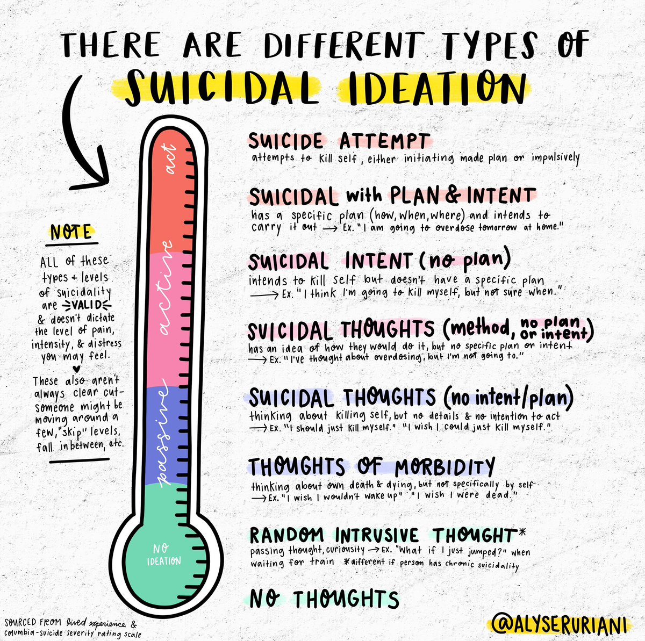
Suicidal Ideation
What is it?
Suicide: defined by the Centers for Disease Control and Prevention as “death caused by self-directed injurious behavior with an intent to die as a result of the behavior”
Suicide Ideation: Strictly speaking, it is thinking about wanting to take your own life or having thoughts of suicide

Slide 7
Polls
How many of you have had a client that disclosed Suicidal Ideation?
How prepared did you feel to address this issue?

Slide 8
Suicide vs Self Harm
What does self-harm look like?
Superficial cutting of the skin
Hitting or beating
Hair-pulling
Burning
Initiating physical conflict – this is important to be aware of for clients in detention settings

Slide 9

Wellness Break

Slide 10
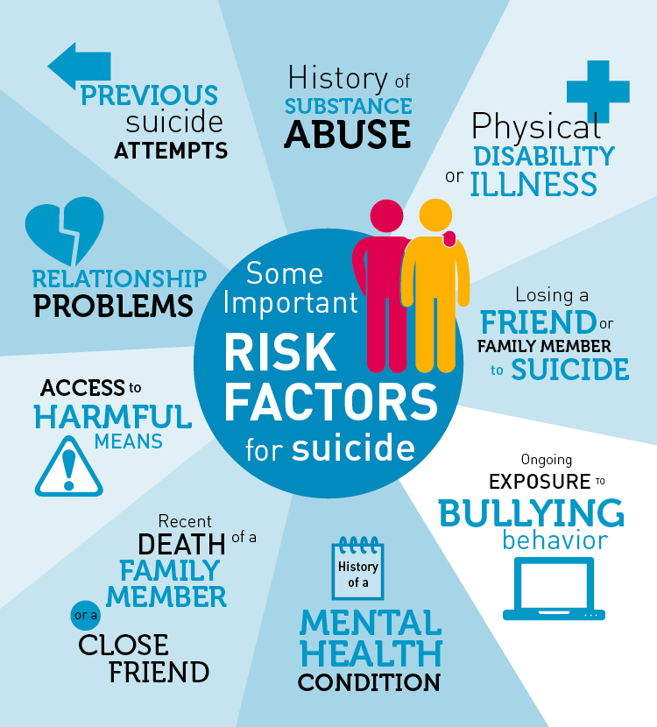
What are Risk Factors?
Risk factors are characteristics that make it more likely that someone will consider, attempt or die by suicide
They can't cause or predict a suicide attempt

Slide 11
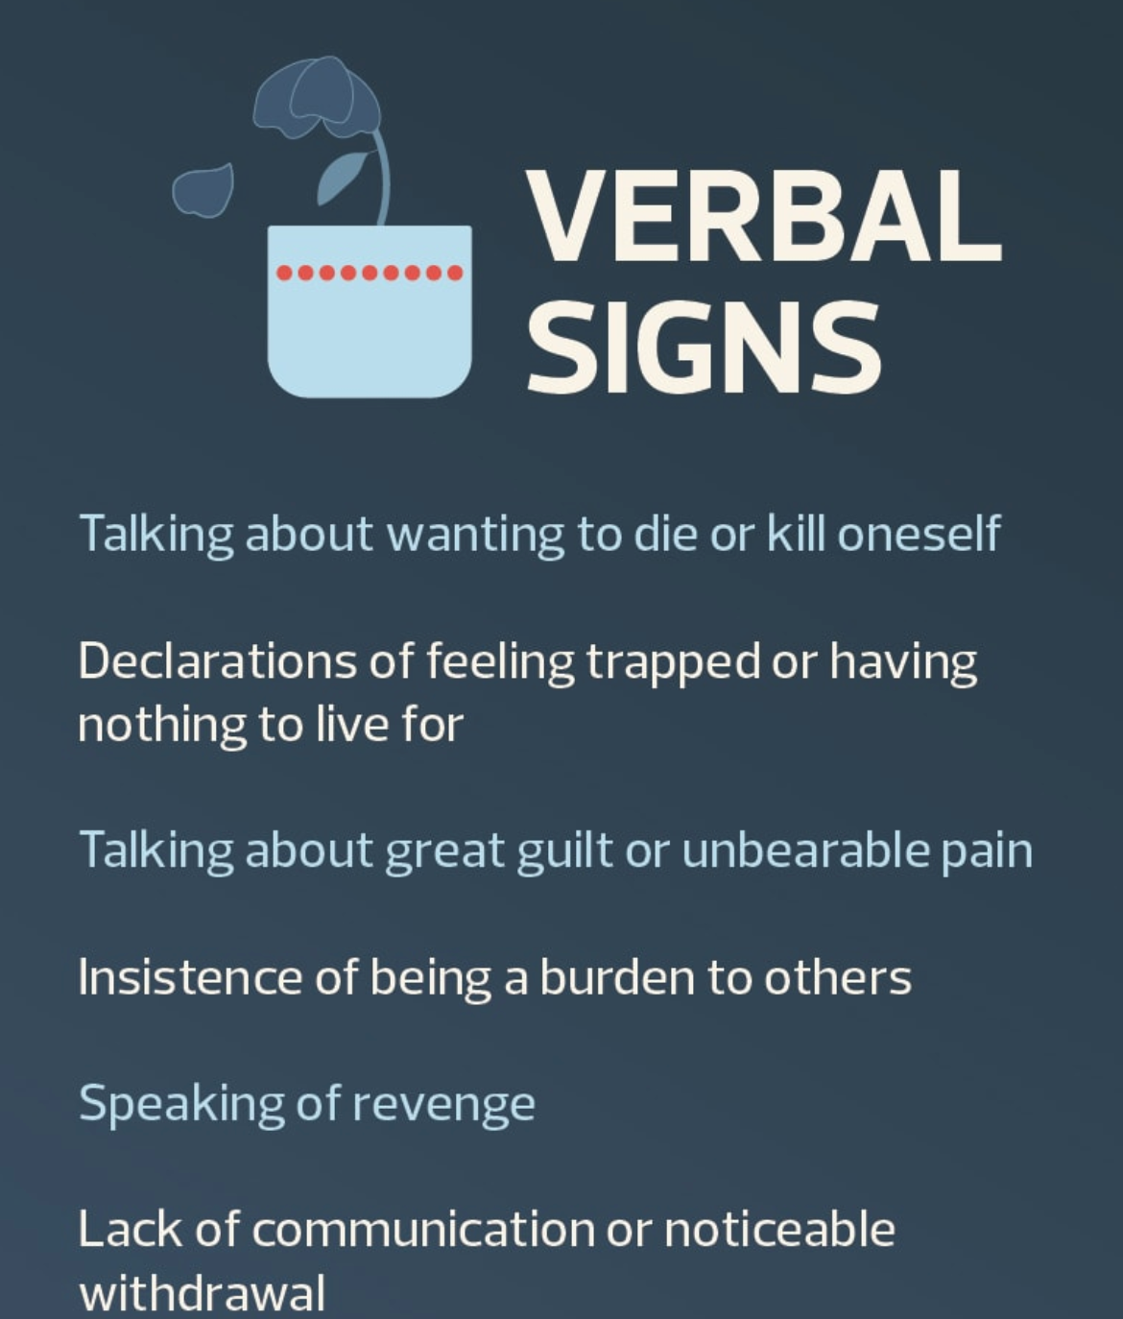
Warning Signs
It is crucial to observe for warning signs in determining someone’s risk for suicide
If your client exhibits these behaviors seeking help could be called for

Slide 12
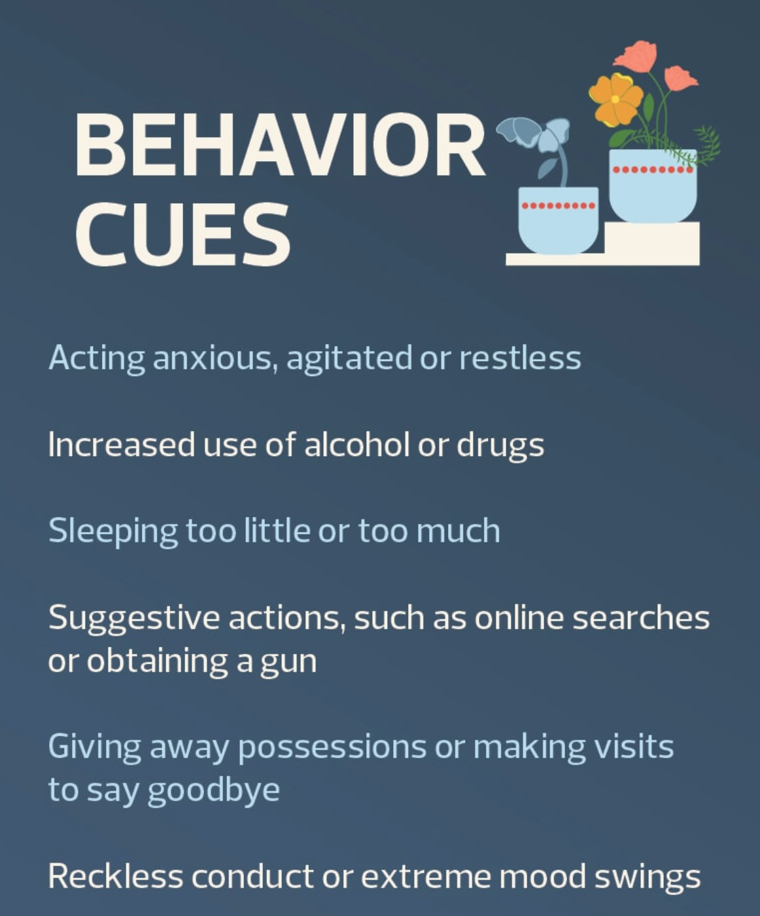
Warning Signs

Slide 13
Social and Cultural Context
Social context of how society views immigrants and the mentally ill
Racism is a public health issue
Important in understanding your clients intersectional experience and how you go about your legal work
The environmental context of being detained and what that entails
How can that increase suicidal ideation
Microcosm of detention can potentially "normalize" or overlook the client's behavior
QR's and potential for protective factors
Cultural differences and views on suicide can influence protective factors and the development of safety plan for the client

Slide 14

Wellness Break

Slide 15
What can you do?
Don't panic!
Ask questions!
Have you given any thought of how you would harm/kill yourself?
How often do you usually have them?
When do you find yourself thinking them?
Have you ever acted upon any of these thoughts?
Asking about suicide does not increase suicide risk.
3) Validate their feelings!
You may feel like you’re alone, and it’s ok to feel down, but you have people on your side.
Being in detention is tough, and just getting up everyday and being ready for the day is good enough.
The immigration process is confusing, so it’s ok to feel hopeless about your case, but we’re working hard on your defense.
4) Have a plan!

Slide 16
Poll
Does your agency/firm have a protocol in place for when a client discloses thoughts of self-harm or suicide?

Slide 17
Safety Plan: 3 Ws
When to create it?
The earlier the better. (At the onset of client mentioning thoughts of self-harm)
What should it include?
It does not have to be formal (Can write down on a piece of paper coping strategies for client, reading, talking on the phone to friends/family, talking to a chaplain, etc.)
Who should have a copy?
Anyone who is “on their team” (QRs, social workers, family/friends, other MH providers, chaplain, etc.)
Additional Question: When is a safety plan not enough?

Slide 18
Protective Measures
Meaningful relationships: friends/family/pen pals
Family responsibility (i.e., being married or a parent)
Cultural or Religious/Spiritual beliefs
Coping skills to deal with stress
Opportunities to stay busy
Self-esteem and purpose
Hope
Restricted access to lethal means

Slide 19
Sample Safety Plan
A list of memories, people, places, etc. that brings safety/positive thought to client
Signing them up for a book delivery service (i.e. Prison Book Program)
Having enough money in their commissary to make calls
Setting them up with a pen pal
Encouraging the client to meet with a chaplain
Magazine cut outs of things that bring client joy/hope
List of coping strategies that you have practices with the client (i.e. breathing exercises, grounding techniques, etc.)
Name and number of someone they can call
Linking client up with things that keep them busy while in prison/detention

Slide 20
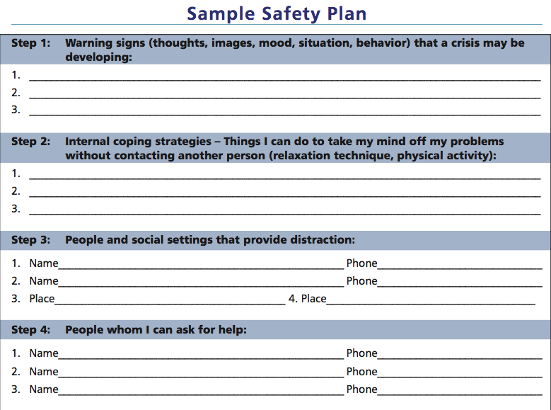
Sample Safety Plan

Slide 21

Wellness Break

Slide 22
Asking for Reasonable Protective Measures
If your client is currently working with a mental health professional, find out how often and if client needs to meet them more frequently.
If your client has no access to mental health services, see if you can get them connected with a therapist via phone.
If a client is in solitary and does not want to be, consider filing a CRCL complaint and advocating for your client to be taken out of solitary.
Specific for the NQRP Network: If your client needs transportation to mental health services, this can potentially be funded. Send us a funding request email and we can see how we can help.

Slide 23
Detained Clients
Let client know that you're there for them, even if you can't physically be there for them. (i.e., with supportive words, the use of a transitional object, etc.)
Help them develop a safety plan.
If your office has a social worker, ask them to set up visits.
If the client is religious, consider reaching out to the appropriate clergy (they usually have decent access to local facilities).
Many facilities lack mental health services for detainees. IF you can, arrange for client to have phone or visitor access to mental health providers.
Help your client build their team.

Slide 24
Non-Detained Clients
Let client know you’re there to help and support them. Remain person-centered and strength based when discussing their trauma and their SI/thoughts of self-harm.
Learn about the safety plan developed by your client and their mental health professional. Keep a copy in their file (or somewhere else easily accessible) and make sure the client has a copy. Also, have copies available to any friends/family that are supporting client.
If there is no safety plan is in place, advocate for your client to have one developed by their therapist.
Connect them with area resources for mental health support and suicide prevention.

Slide 25
Suicide Watch
Risks of Suicide Watch:
Suicides are more likely to occur while a person is in segregation/suicide watch than in the general population.
Most suicides in prison occur by hanging, primarily while in segregation and when observation is light.
Alternatives:
Access to mental health treatment
Social intervention
Increased communication
Better training for detention staff

Slide 26

Wellness Break

Slide 27
Client Example
Client A is a 35 year old male from Somalia. After experiencing the Somalian civil war as a child, client A came to the United States at 15 with his family and overstayed his tourist visa. He lived in a relatively robust community of Somalian immigrants and refugees. In his early 20s, client A was diagnosed with bipolar disorder, which he is currently on medication for. Client A has a child through a former partner and plays an active parenting role. Prior to detention, he worked as a bagger at a grocery store and was a team member in a local soccer league. Recently, Client A disclosed that a cousin he had a close relationship with passed due to suicide. He has stated feelings of loneliness and hopelessness while in detention since he is unable to talk to his child or other loved ones. Client A’s ICE facility has relatively high COVID rates, which client A has expressed as cause for concern. Client A stated that he feels his case is taking too long and he would rather die on his own terms than potentially contract COVID and die alone.

Slide 28
Break Out Rooms (10 min)
Identify Protective factors
Identify Risk Factors
Develop a Safety Plan

Slide 29
Important Takeaways
Suicidal thought and thoughts of self-harm are common to those in detention settings. It’s ok to ask clients if they have ever experienced them.
Validate your client’s feelings.
Develop a safety plan.
Advocate for your client to receive appropriate mental health treatment both in and out of detention.
Realized that you’re just one person and may need help providing support for your client. Build a team and have tools ready so you’re prepared before your client discloses.
Your client is eventually responsible for their own thoughts and actions. While you can provide them with support and strategies to cope, being person-centered means they have agency over their own actions.

Slide 30
Questions?

